Slide 1
Introducing The IPitomy IP320, IP330 & IP410
IP Telephones
3rd Call Key
IP330
IP320, IP330*
* IP330 is exactly like the IP320 but has three line keys
IP410
2/3 Call/Line Keys
4 Call/Line Keys

Slide 2
Things you should know about your IP Telephone system
The IPitomy system has many of the same features of traditional business telephone systems.
The telephone has some new functionality that streamlines the way your phone operates.
Some of the features you will recognize from past business telephone systems you have used before.
Some of the features you may recognize from cell phone technology.
It won’t take you long to get acquainted and appreciate the new technology and start to get the most out of it.

Slide 3
What is so different about IPitomy?
The system runs on the LAN (Network). It shares the network with all of the other devices like PC’s, printers and routers.
The phones can be unplugged from the LAN and plugged in anywhere and the phone extension number stays the same.
Phones can be configured to work anywhere there is a broadband Internet connection; including from anywhere outside the building.
IPitomy phones are designed to use High Definition HD Voice audio delivering exceptional audio quality.

Slide 4
What should I expect with my new phone?
Your new phone has Business Telephone features:
Transfer, park, call pickup, etc.
Some of the features are new:
Missed, Answered and Dialed Call Logs
Call forwarding to mobile phones
Single button for call transfers
Voice Mail to Email
No need to put a call on hold to answer another line; just press the line key and the first caller is automatically placed on hold.
Much more…

Slide 5
Knowing the Basics
Fixed keys
Soft Keys
Call Keys
Programmable Keys
Navigation Keys
All Clear Button
Big Red Button
3rd Call Key
IP330
1
1
3
3
2
2
4
4
5
5
6
7
6
7

Slide 6
Fixed Keys
Headset – use headset as primary instead of handset
Mute
Voice Mail– Lights up red when new messages are available. Press to retrieve new messages
Directories – Phonebook, Call History – Missed, Received, and Dialed calls
Menu – preferences and options for customizing phone programming
Service Button reserved for future use
1
2
3
4
5

Slide 7
Fixed Keys…
Volume – + increases volume, - decreases volume
Conference – Press the conference key once while on a call, dial the next number, when the party answers, press conference again to create a conference call
Redial – Dials the last number dialed
Transfer– Press transfer while on a call to send the call to another party. Press the blind soft key first then enter the number you wish to transfer to and press transfer again to complete the blind transfer. For an attended transfer, wait for the party to answer and press transfer again to complete the transfer or cancel to get the call back.
Hold – Press to place a call on hold. Press the flashing green call key to retrieve the call from hold.
1
2
3
4
5

Slide 8
Soft Keys
Dynamic Context-Sensitive Soft Keys – Add helpful actions while a call is in progress
Keys change based upon the call progress.
Blind Transfer
Send (make call)
Dial (from Log)
End Call
Many others
3rd Call Key
IP330

Slide 9
Call Keys
Each Call Key represents a separate call on your phone.
Call Key Lamps are the same on both the IP320 and IP410.
The ICON’s are slightly different on the models, shown is the idle condition on each.
Idle Call Lamp
Idle Call Key ICON IP320
Idle Call Key ICON IP410
3rd Call Key
IP330
IP320 has 2 Call Keys
IP410 has 4 Call Keys

Slide 10
Calls – Making A Call (choices)
There are choices for placing a call… you may:
Pre-dial (allows you to make corrections)
Activate a line and then dial
Calls may be initiated in one of the modes:
Handset
Speakerphone
Headset
3rd Call Key
IP330

Slide 11
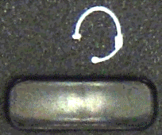
Calls – Making A Call – Pre-dial
Pre-dial:
Start dialing the number. It will appear on the display as dialed… use the Soft Keys to make corrections if necessary
Then initiate the call…
Initiate Call:
Handset:
Lift the handset…
Speakerphone:
Press Big Red…
Headset:
Press the Headset Button…
…the call is placed
3rd Call Key
IP330

Slide 12
Calls – Making A Call – Access First
Active then dial:
Lift the Handset, or;
Press Big Red, or;
Press the Headset button
Then dial the number…
When finished dialing you can:
wait for the system to determine you have finished and place the call for you, or;
Press or to place the call
3rd Call Key
IP330

Slide 13
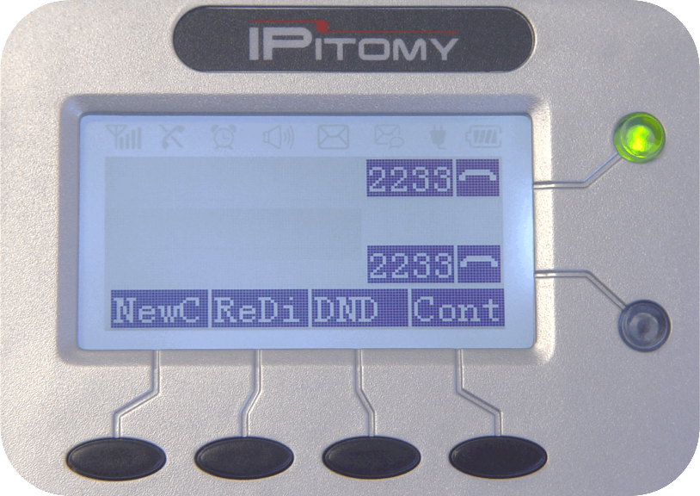
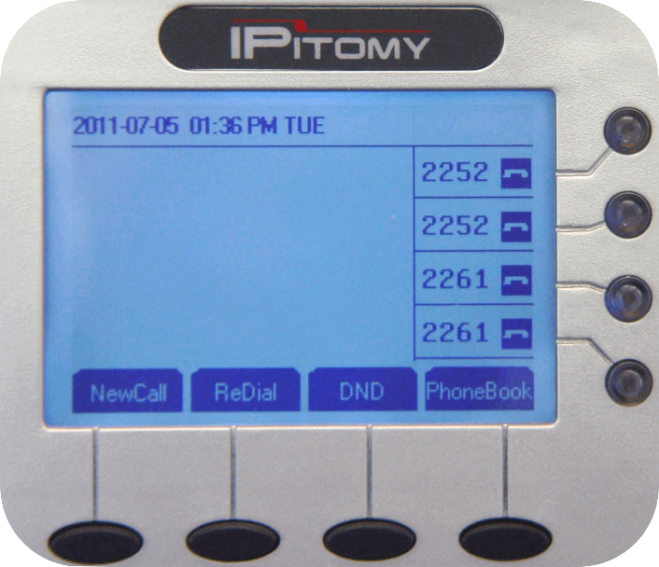
Calls – Ringing & Answering
When calls are ringing on a Call Key the ICON will appear as shown and the associated Call Key lamp will flash red.
Caller ID Name & Number will appear:
IP410 adjacent to the Call Key ICON
IP320 in the lower left corner
Answer the call by:
Reject the call and send to voice mail:
Lifting the Handset
Press Big Red
Pressing the flashing Call Key
Pressing the Headset button
Press Soft Key
Press Soft Key
3rd Call Key
IP330
8005551234
“Bernard Rubble”
8005551234
“Bernard Rub
Call Key Idle ICON IP320
Call Lamp – Flashing Red
Call Key Idle ICON IP410

Slide 14
Call Keys – Active Line
When a call is active on your telephone the Call Lamp will be lit steadily green and the associated ICON will appear as shown.
Once answered, the CID information and call timer are displayed.
3rd Call Key
IP330
“Bernard Rubble”
00:01:43
8005551234
00:00:44
Call Lamp – Steady Green
Call Key Active Line ICON IP320
Call Key Active Line ICON IP410

Slide 15
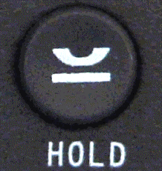
Calls – Placing a Call on Hold
While connected to a call you may like to hold the current call to answer or place another call. To hold a call:
Press or , or;
Access another Call Key to answer or place your next call
3rd Call Key
IP330
Call Lamp – Flashes Green
Call Key Line Inactive ICON IP320
Call Key Held Line ICON IP410

Slide 16
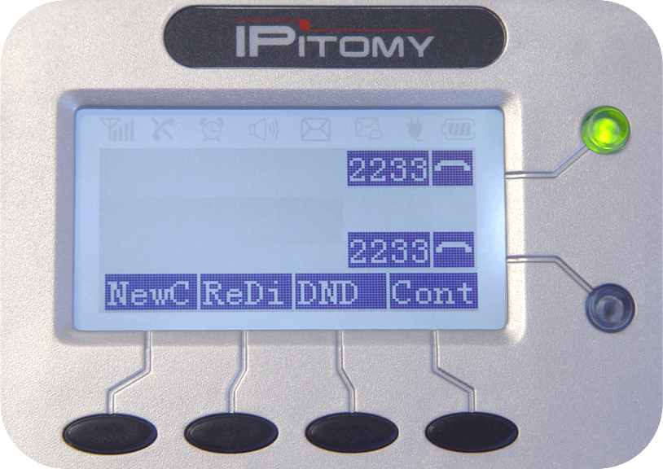
Calls – Call Transfer - Announced
Call Transfer allows you to deliver a call directly to the destination you wish. There are two choices when transferring a call: Announced or Blind Transfer
Announced
Transfer:
While connected to a call:
Press or
You will be prompted to input the destination, input extension
Press or
Wait for the person to answer and announce the call to them
Press or to complete the transfer
3rd Call Key
IP330
Transfer to
Transfer to:
Call Lamp – Lit Steady Green
Call Key Line In-Use ICON IP320
Call Key Transfer ICON IP410

Slide 17
Calls – Call Transfer - Blind
Blind Transfer (no announcement – just transfer the call):
While connected to a call:
Press or
You will be prompted to input the destination
Press
Input the extension
Press or … the call is transferred to that extension
3rd Call Key
IP330
Transfer to
Transfer to:
Call Lamp – Lit Steady Green
Call Key Line In-Use ICON IP320
Call Key Transfer ICON IP410

Slide 18
Calls – Call Transfer – Voice Mail
Voice Mail Transfer (Call goes directly to voice mail – does not ring extension)
While connected to a call:
Press or
You will be prompted to input the destination
Press
Press
Input the extension
Press or … the call is transferred to that extension’s VM Box
3rd Call Key
IP330
Transfer to
Transfer to:
Call Lamp – Lit Steady Green
Call Key Line In-Use ICON IP320
Call Key Transfer ICON IP410

Slide 19
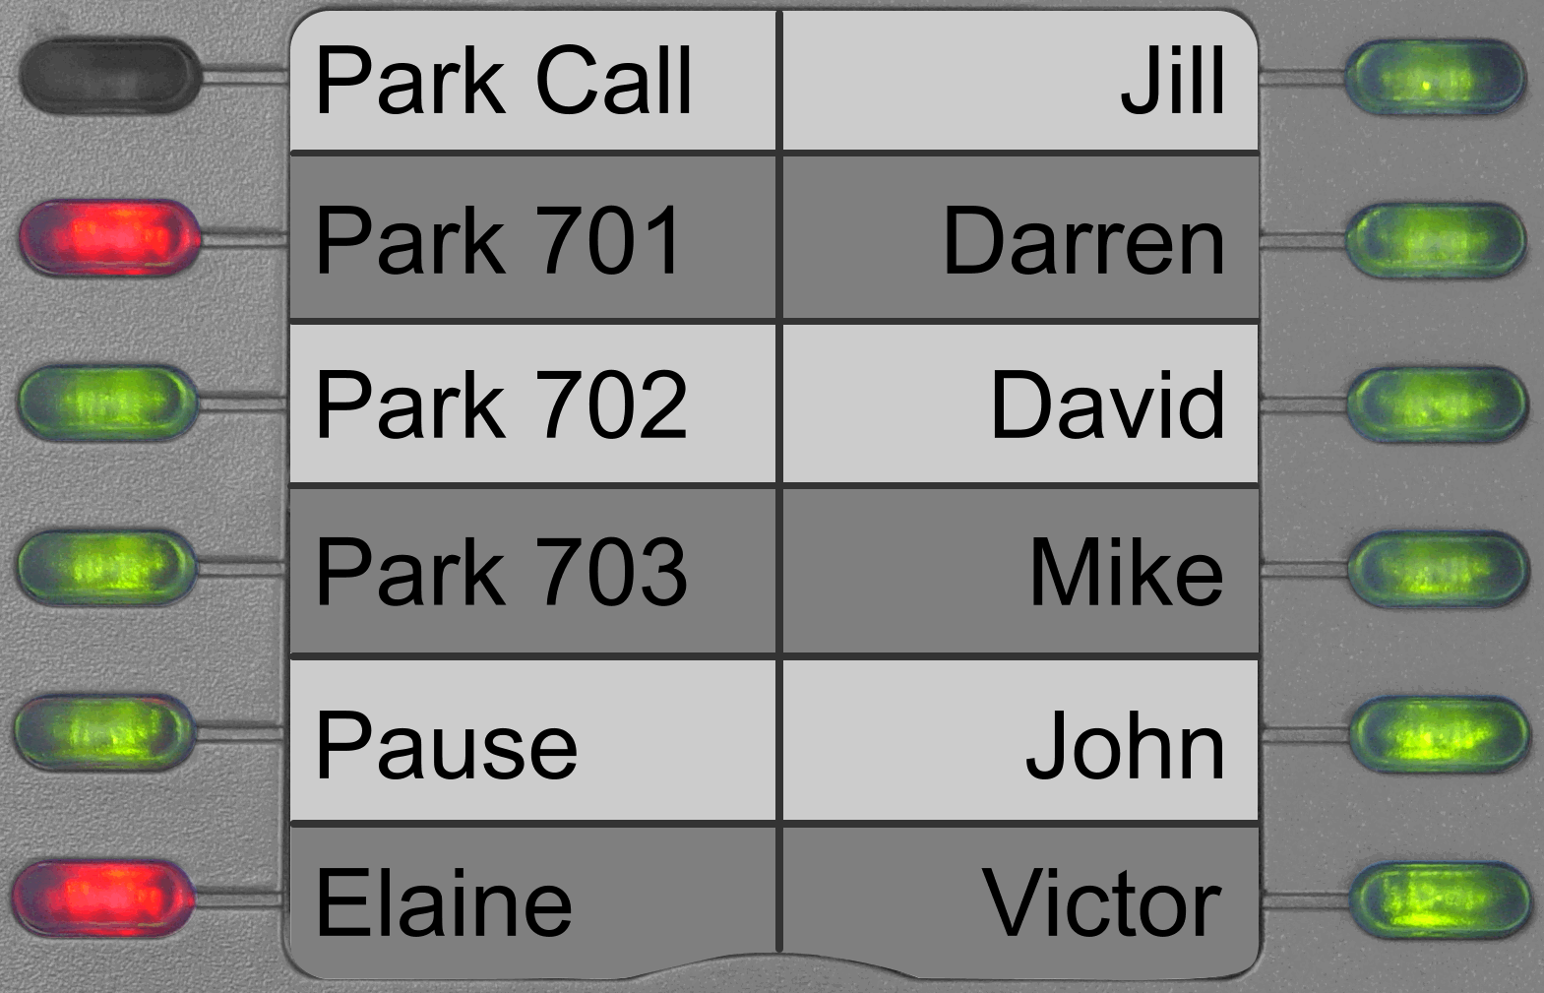
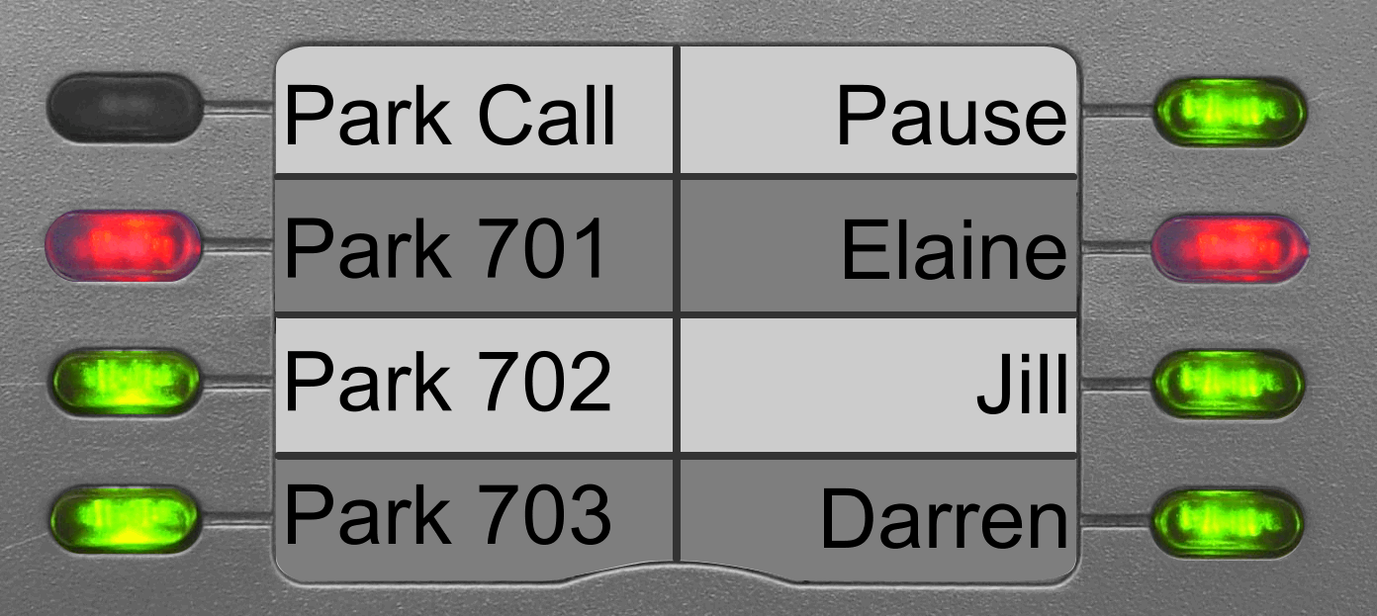
Calls – Call Park
Sometimes calls must be delivered in a general delivery fashion, this is accomplished with Call Park. (There are 20 shared Call Park locations.)
A Call that is Parked can be picked up from any PBX extension
While connected to a call:
Press
The IPitomy system will announce to you the park location where the call has been parked
To Retrieve a Parked Call
Press the red Park Button where the call is parked; or
Dial the park location number 701-720 at any extension
Park Location buttons will light Red to indicate a Parked Call
Programmable Buttons IP320
Park 701 shown with parked call
Programmable Buttons IP410
Park 701 shown with parked call
Note: To park use “Park Call” button. Use Park 701… 702… 703 to Pick Up a parked call.

Slide 20
Calls – Conference
Your IPitomy HD SIP telephone can conference two parties together at your extension to form a 3-way Conference (you and 2 others).
To establish a conference…
While connected to your first call:
Press or you will hear dial tone
Dial your second call number making corrections in needed
Press or to speed call progress
When your second call is connected, press or
All parties are joined in a 3-way conference
Notes:
A conference call be placed on hold, press Hold
press the Held Call Key to rejoin the conference
When on hold, the two [other] parties cannot speak to one another
You may hang up and exit a conference …leaving the [other] parties connected
Call Key Line In-Use ICON IP320
Call Key Conference ICON IP410

Slide 21
Call Logs – Dialed Numbers
Call Logs allow you to review calls at your telephone. From the Call Log you also have the ability to dial the call number or save the number in your Phonebook
Dialed Numbers:
press the RIGHT Navigation Key
3rd Call Key
IP330

Slide 22
Call Logs – Missed Calls
Call Logs allow you to review calls at your telephone. From the Call Log you also have the ability to dial the call number or save the number in your Phonebook
To access:
Dialed Numbers
Missed Calls
Received Calls
Use the center navigation rocker switch to select which call list to view.
Press show or right arrow navigation key to see the list.
Use the rocker switch to select the call from the list.
Press Detail to select the call.
Dial the number by pressing dial
Save to the phone book (PB)
Press Quit to exit
Dialed Numbers:
press the RIGHT Navigation Key
Missed Calls:
press the DOWN Navigation Key
3rd Call Key
IP330

Slide 23
Call Logs – Received
Call Logs allow you to review calls at your telephone. From the Call Log you also have the ability to dial the call number or save the number in your Phonebook
To access:
Dialed Numbers
Missed Calls
Received Calls
Use the center navigation rocker switch to select which call list to view.
Press show or right arrow navigation key to see the list.
Use the rocker switch to select the call from the list.
Press Detail to select the call.
Dial the number by pressing dial
Save to the phone book (PB)
Press Quit to exit
Dialed Numbers:
press the RIGHT Navigation Key
Missed Calls:
press the DOWN Navigation Key
Received Calls:
press the LEFT Navigation Key
3rd Call Key
IP330

Slide 24
Using Call Logs
Use the Navigation Keys to select the specific call within the call log being viewed.
In the Call Log: Dialed Numbers, Missed Calls, Received Calls …you can select a specific call using the Navigation Up/Down Keys then:
Press to dial the log number, or;
Press to see the call log details and/or to save the number in your phonebook
To access:
Dialed Numbers
Missed Calls
Received Calls
Use the center navigation rocker switch to select which call list to view.
Press show or right arrow navigation key to see the list.
Use the rocker switch to select the call from the list.
Press Detail to select the call.
Dial the number by pressing dial
Save to the phone book (PB)
Press Quit to exit
3rd Call Key
IP330

Slide 25
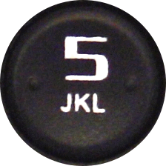
Voice Mail
IPitomy’s IP PBX is equipped with a powerful voicemail system. One simple button provides you with access to this system and notifies you when messages are waiting.
Setup your voicemail:
Making your voicemail greeting personal and changing your password is the first thing to do.
Press the key and enter your password (factory set to your extension number)
Press to enter into mailbox options………………………………….
Follow the instructions to record the various greetings
Messages waiting:
When voice messages are waiting in your voicemail box the Voicemail key lamp will light red.
Retrieving messages:
Press , you will be prompted to enter your password
Input your password
Follow the instructions to review those messages in your mailbox
Greetings:
Unavailable
Busy
Name
Temporary
Change Password

Slide 26
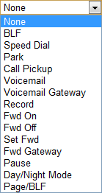
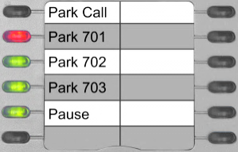
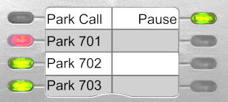
Programmable Keys
Programmable Keys may be assigned to accommodate features frequently used.
Those set at the factory are:
Park
Pickup 701
Pickup 702
Pickup 703
Pause
3rd Call Key
IP330
Notes:
Keys assigned “None” have no function
Use Smart Personal Console to program your keys.

Slide 27
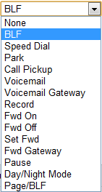
Programmable Keys – BLF
Programmable Key – BLF
BLF is Busy Lamp Field
Typical uses are:
monitoring other extensions
Answering calls ringing at monitored extensions
Monitoring Call Park Locations (701-720)
A monitored extension BLF will flash when that phone is ringing …you may press that flashing BLF to answer the call ringing at that extension.
Note: Use Smart Personal Console to program your keys.

Slide 28
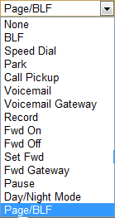
Programmable Keys – Page BLF
Programmable Key – Page BLF
Page BLF is similar in most respects to a BLF Key… the difference being that when pressed, this key will cause the called telephone to answer automatically in hands-free (speakerphone) mode thereby allowing the called extension to reply without interaction.
The extension monitored with a Page BLF Key must have this option set in programming to allow this call type. If not allowed, the call will ring as with a regular BLF.
Note: Use Smart Personal Console to program your keys.

Slide 29
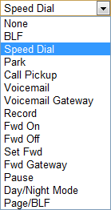
Programmable Keys – Speed Dial
Programmable Key – Speed Dial
Use Speed Dial to store any number you wish to dial by pressing just this key.
Note: Use Smart Personal Console to program your keys.

Slide 30
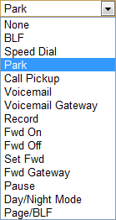
Programmable Keys – Park Call
Programmable Key – Park Call
A “Park Call” Key is used to place a call into an available Call Park Location (701-720). When doing so, the system will advise you verbally the park location into which the call has been parked.
Park Call is also possible by pressing Transfer and entering the Park Call code: 700
Note: Use Smart Personal Console to program your keys.

Slide 31
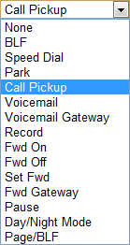
Programmable Keys – Call Pickup
Programmable Key – Call Pickup
Calls ringing at other extensions can be answered from your telephone using the Call Pickup feature.
To pickup a ringing call press the key programmed with this feature.
Call Pickup is possible by dialing the code: 99
Call Pickup is associated to Call Groups – To pickup a call ringing at another extension, your extension must be in the same Call Group.
An extended variation of this feature is Directed Call Pickup – which can be used to answer ringing extensions that are not in your Call Group. This is done using code: 99 + the extension number where the call is ringing.
Note: Use Smart Personal Console to program your keys.

Slide 32
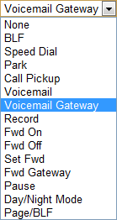
Programmable Keys – Voicemail Gateway
Programmable Key – Voicemail Gateway
Voicemail Gateway is used to access the IPitomy voicemail system at the top-most level. This can be effective for transferring callers to the voicemail system where they can then traverse the system as they wish.
To transfer a caller to the Voicemail System Gateway; while connected to a call press transfer, then press the soft key Blind, then press the Voicemail Gateway key.
The Voicemail Gateway can also be accessed by dialing the code: 924
Note: Use Smart Personal Console to program your keys.

Slide 33
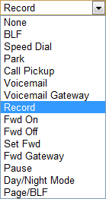
Programmable Keys – Record
Programmable Key – Record
Record is used to store the audio of your conversation in a voicemail file that can be retrieved and replayed later.
To record a call; while connected to a call, press the Record Key.
This recording is stored in your voicemail under the folder: “Work”
This recording can be retrieved via SPC (Smart Personal Console) and downloaded to a computer.
Note: Use Smart Personal Console to program your keys.

Slide 34
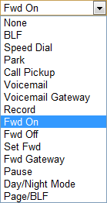
Programmable Keys – Forward ON
Programmable Key – Forward ON
Call Forward allows you to redirect calls to your telephone to some other destination. This might be an extension, voice mail, a menu, cell phone… or other. Use the Call Forward – ON Key to activate Call Forward to the preset forward destination.
To activate Call Forward; press the Call Forward – ON key.
You can activate Call Forward using the code: *91
Call Forward – ON also provides the opportunity to set a new destination.
Note: Use Smart Personal Console to program your keys.

Slide 35
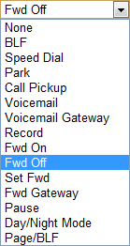
Programmable Keys – Forward OFF
Programmable Key – Forward OFF
Use the Call Forward – OFF Key to deactivate Call Forward.
To deactivate Call Forward; press the Call Forward – OFF key.
You can deactivate Call Forward using the code: *90
Note: Use Smart Personal Console to program your keys.

Slide 36
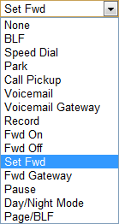
Programmable Keys – Set Forward
Programmable Key – Set Forward
Use Set Forward to input a new destination – bypassing the menu.
To set your extension’s Call Forward Destination; press the Set Forward key, then input the number to which calls will be forwarded
You can access Set Forward using the code: *92
Note: Use Smart Personal Console to program your keys.

Slide 37
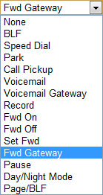
Programmable Keys – Forward Gateway
Programmable Key – Forward Gateway
Use the Forward Gateway to set the Call Forward status at another extension. Doing so requires that extension’s password.
To set an extension’s Call Forward status; press the Set Forward key, then input the extension number and the password and follow the prompts for the options available
You can access Set Forward using the code: *9
Note: Use Smart Personal Console to program your keys.

Slide 38
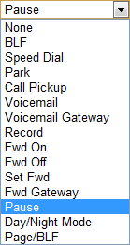
Programmable Keys – Pause
Programmable Key – Pause
Pause is used to set Do Not Disturb at the PBX level. This is important in IP-based systems since a SIP telephone’s DND mode is local to the telephone only.
To set Pause; press the Pause key
To deactivate Pause, press the Pause Key again
Pause will alert other PBX extension users of your status… when you activate Pause, your Pause Key will light and BLF Keys of your telephone at other extensions will be lit indicating that you are unavailable.
Note: Use Smart Personal Console to program your keys.

Slide 39
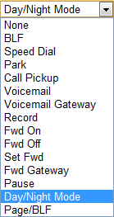
Programmable Keys – Day/Night Mode
Programmable Key – Day/Night Mode
Day/Night Mode is a means of altering the ringing pattern of the IPitomy IP PBX. The Day/Night Mode Key can be use to active any mode: Day/Night/Schedule
Press the Day/Night Key to enter into mode selection then follow the prompts to select the mode desired.
Requires that the extension using this feature is designated as the Operator
This technique is seldom used since the Schedule feature is far more comprehensive and operates without user action.
Note: Use Smart Personal Console to program your keys.

Slide 40
SPC – Smart Personal Console
Smart Personal Console is a web-based application that allows you access to the settings of your telephone. The SPC Graphical User Interface makes setting telephone options easy.
SPC allows access to:
Home Screen
Received Calls Log
Voicemail (new folder)
Account Settings
Voicemail Settings
Forward Settings
Your Phone Settings
Program Keys & Print Key Labels
Adjust volume settings
Enable/Disable Headset Mode
Setting Network connections
Set Time Server
Set Configuration Updates
Adjust Display Settings
Program Expansion Module Keys & Print Expansion Module Key Labels
Your Schedule
Call Logs (All)
Voicemail
Review all Folders
Manage Messages
Download Messages
Set/Upload Greetings
IMPORTANT:
Changes can be made in many ways BUT those changes performed using SPC are retained in the PBX memory where they are backed-up and restored. Often this backup/restore operation is set to operate daily.
If you want your settings to stay put, use SPC to make all changes.

Slide 41
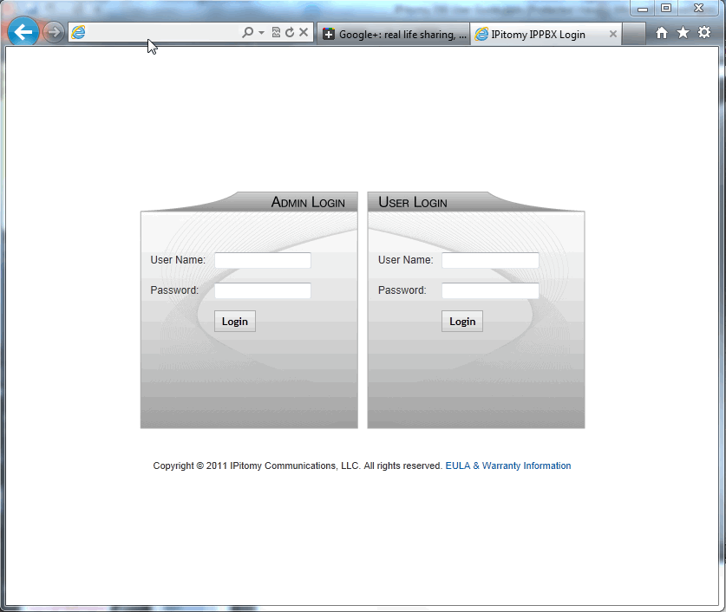
SPC – Access
To access Smart Personal Console
Open a web browser (preferably Mozilla Firefox or Apple’s Safari).
In the Address Bar, input the IP Address of the IPitomy IP PBX installed at your location.
Obtain this address from your system administrator.
Press Enter/Return
You should see the screen pictured here
In the User Login panel in the User Name field input your extension number
In the Password field input your extension password
<Initially this is also your extension number>
Security Alert! – Make sure you change your default PIN number from your extension number to any 4 digit number. Make sure it is one you can remember. You will need it to listen to voice mail.
Click the Login button
http://<yourpbxip>/ippbx
your ext num
your ext num

Slide 42
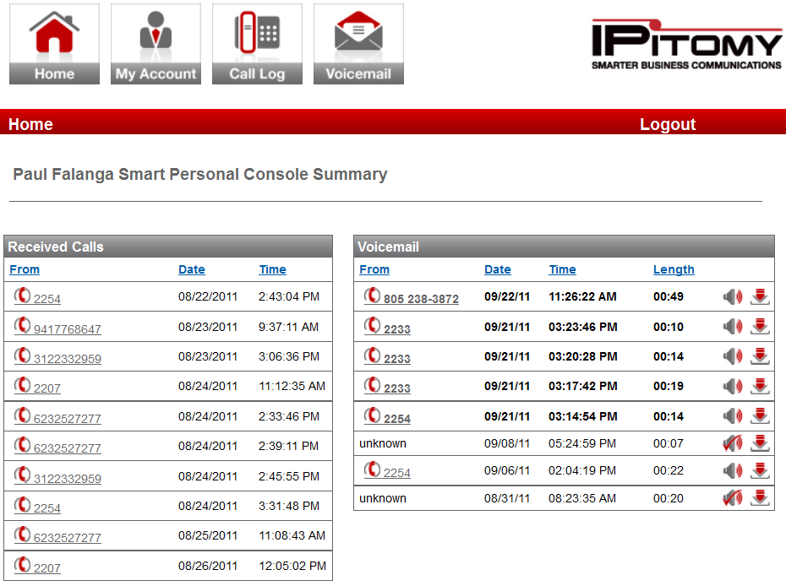
SPC – Home Screen
The SPC Home Screen provides fast access to:
Received Call Log
Click on the number to place a callback to this caller… your phone will ring… when you answer the outgoing call will be in initiated
Voicemail – New Folder
Click on the number to place a callback to this caller… your phone will ring… when you answer the outgoing call will be in initiated
Click on the icon to listen to the voice message on your computer
Click on the icon to download the voice message to your computer
your name

Slide 43
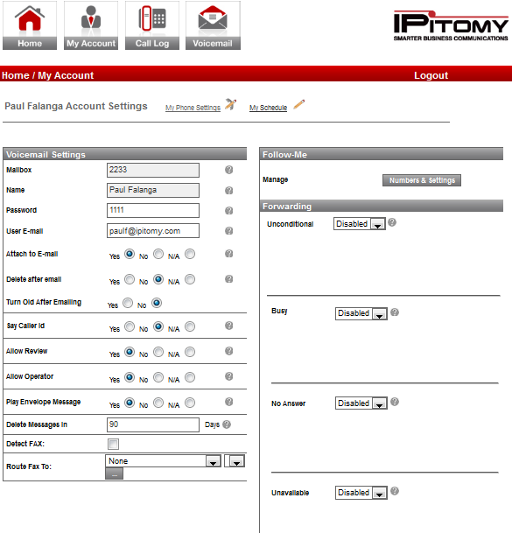
SPC – My Account
SPC My Account Screen provides fast access to:
View Mailbox Name and Number
Set Password
This sets both voicemail and SPC password
Email Address – where voice message will be delivered in WAV file format
Attach to Email – Y/N
Delete After Emailing – Y/N
Turn Old After Emailing – Y/N
Say Caller ID – before playing message
Allow Review – gives caller the ability to review their message before finalizing
Allow Operator – caller can dial “0”
Play Envelope – automatically before MSG
Delete MSG’s in X days
Detect Fax
Destination for FAXes
Follow Me feature settings
Forwarding Settings (permission req)
My Phone Settings (permission req)
Volume, Features, buttons, & more
My Schedule (permission req)
Business Hours / After Hours / Lunch settings for time and ringing destinations
your name

Slide 44
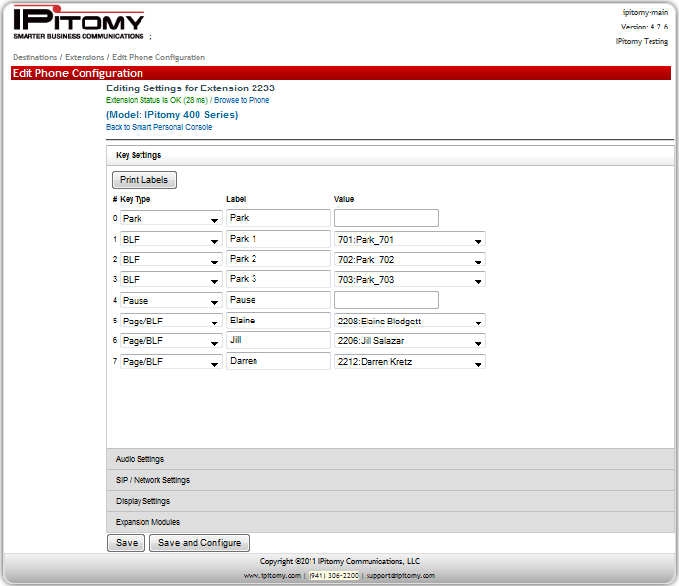
SPC – My Account – My Phone Settings
SPC My Account – My Phone Settings:
Phone Settings is your telephone’s programming stored in the PBX. You can program your Programmable Keys and many of your telephone’s feature settings.
Key Settings
Program Keys
Print a label for your telephone
The content of the “Label” field is used for this purpose –.
Audio Settings
Volume settings
Headset/Ringer Modes
SIP / Network Settings
Make no changes unless directed to do so by your network administrator
Display Settings
Set Backlight conditions / mode
Set idle BLF lamp to Off/Green
Expansion Settings
Program Keys for your Expansion Module (if equipped)
Print Labels for your Expansion Module
Note: When printing labels just use plain paper and cut them out with scissors.

Slide 45
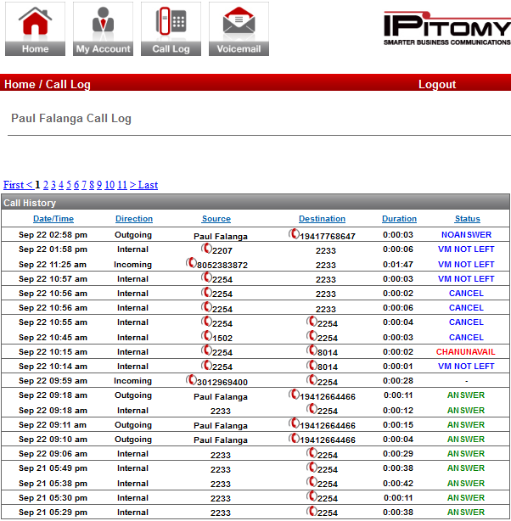
SPC – Call Log
SPC My Account – Call Log:
This is a complete call log of all call traffic to/from your telephone.
The Call Log screen:
Allows you to review calls that have occurred on your telephone
Displays conditions about each call:
Date/Time
Direction Inbound/Outbound
Source
Destination
Call Duration
Status (comments)
When numbers are displayed these numbers can be used to place a call to that number.
your name

Slide 46
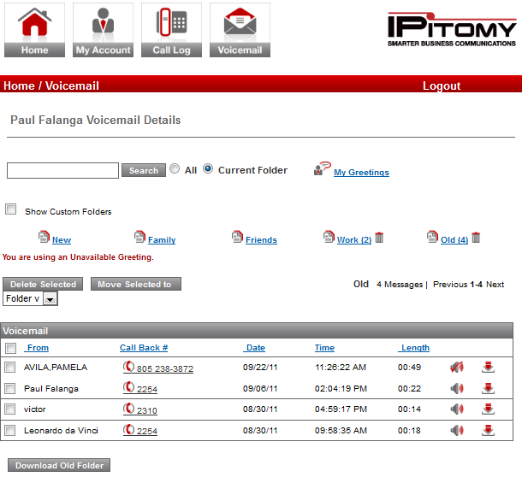
SPC – Voicemail
SPC Voicemail allows access to all voice mail messages and greetings for your voice mailbox.
You can:
View the current greeting in use
View the Caller information received with each message
Search for a message in any folder
Move one/multiple messages to another folder – use the
Checkbox, Folder Pull-down and Move Selected To button
your name
Delete multiple messages
Delete the contents of a folder
Callback callers via caller ID received
Listen to a message over your computer speakers (WAV file format)
Download a message to your computer (WAV file format)
Administer Greetings…

Slide 47
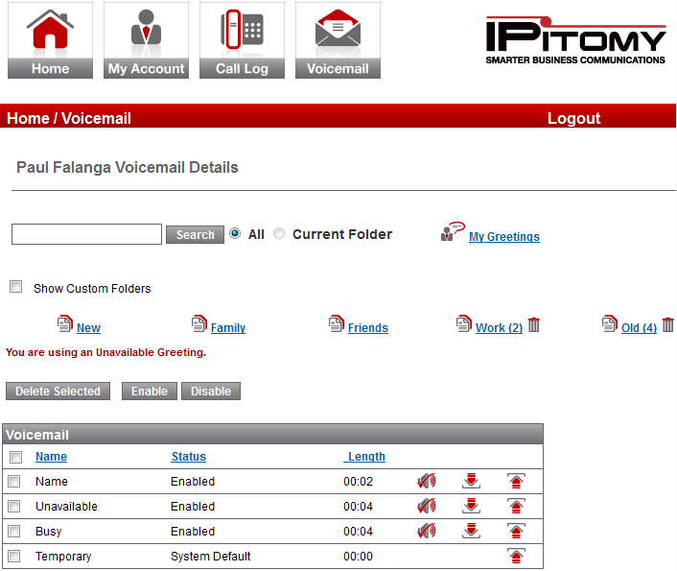
SPC – Voicemail – My Greetings
SPC Voicemail – My Greetings allows you to administer the greetings associated to your voicemail box.
You can:
View the current greeting in use
Enable/Disable the various greetings
Delete greetings (only custom greetings can be deleted)
Listen to greetings
Download a greeting to your computer
Upload a greeting from your computer
your name

Slide 48
User Tips
To end a call, hang up or press .
To page another party press followed by the other party’s extension number. This will cause a speaker phone page.
To page a group of people, press then the appropriate group number. All parties in the group will receive the page.
To pick up a parked call, press the appropriate park pickup key.
Remember that it is not necessary to put a call on hold to transfer the call. Just press
Putting a call on hold; just press another line key or press the transfer button. The caller will be placed on hold automatically.
When placing a call, dial first then go off hook by picking up the receiver or pressing speaker. (Pre-dial method)
If you go off hook first before dialing, remember to press or

